Slide 1
Md. Abdul Malek Assistant Professor, Dept. of Electrical & Electronic Engineering (EEE) Rajshahi University of Engineering & Technology (RUET)

Slide 2
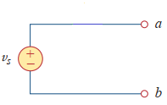
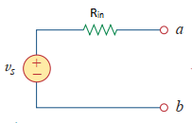
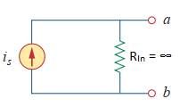
Source Transformation
Ideal voltage source have no internal resistance.
Practical voltage source have series connected small internal resistance.
Ideal Current source have internal resistance. Internal resistance and current source are connected in parallel. Value of internal resistance is infinite.

Slide 3
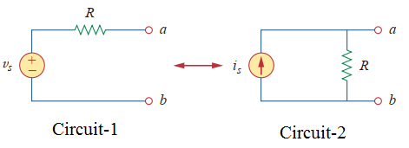
Source Transformation
A voltage source in series with a resistor can be transformed to a current source in parallel with a resistor.
A current source in parallel with a resistor can be transformed to a voltage source in series with a resistor.
Fig. 4: Transformation of independent sources.

Slide 4
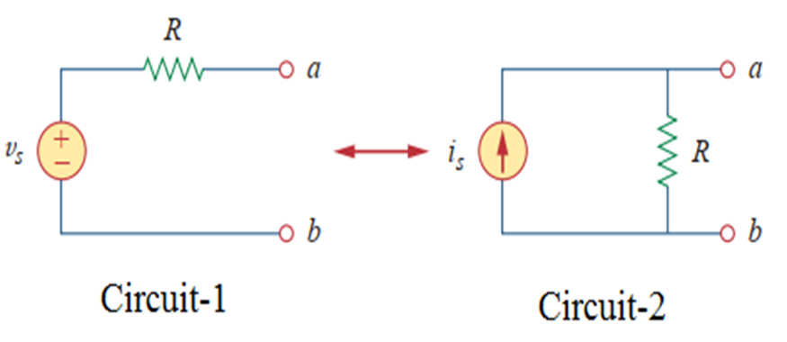
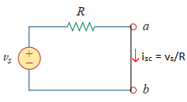
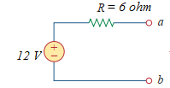
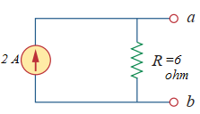
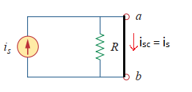



Source Transformation
The two circuits in Fig. 4 are equivalent when they have the same voltage-current relation at terminals a-b.
When terminals a-b of circuit-1 are short-circuited and the short-circuit current flowing from a to b is $i_{sc}=\frac{v_{s}}{R}$.
When terminals a-b of circuit-2 are short-circuited and the short-circuit current flowing from a to b is $i_{sc}=i_{s}$.
Two circuits Fig. 4 are equivalent when short circuit current are same. So relation of source transformation is $i_{s}=\frac{v_{s}}{R}$.

Slide 5
Source Transformation
A source transformation is the process of replacing a voltage source v_{s} in series with a resistor R by a current source i_{s} is in parallel with a resistor R, or vice versa.
Source transformation is not possible when R=0.
Arrow of the current source is directed toward the positive terminal of the voltage source.

Slide 6
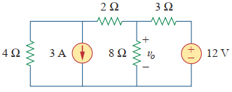
Source Transformation
Problem: Use source transformation to find v₀ in the circuit of Fig. 5.
Fig. 5.

Slide 7
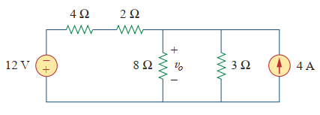
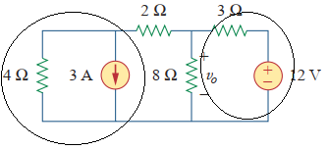



Source Transformation
Solution:
First transform the 3 A current source to voltage sources and 12 V voltage source to current source. This circuit is shown in Fig. 6.
Fig. 6

Slide 8

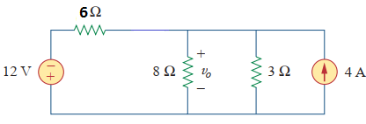
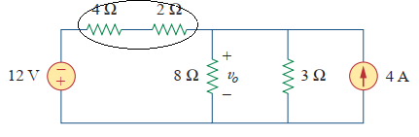

Source Transformation
Combining 4 Ω and 2 Ω the resistors and obtain 6 Ω resistors (shown in Fig. 7).
Fig. 7

Slide 9
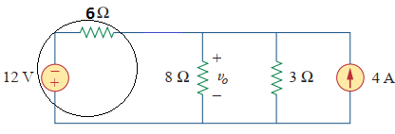
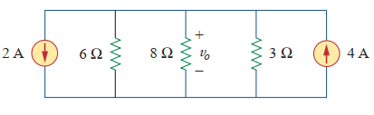


Source Transformation
Solution:
Transforming the 12-V voltage source and 6 Ω resistor to 2 A Current source in parallel with 6 Ω resistors.

Slide 10
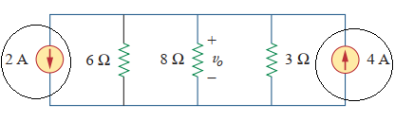
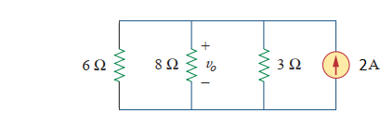


Source Transformation
Combine the 2 A and 4 A current sources to get a 2 A source

Slide 11
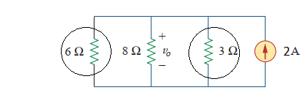
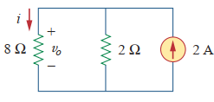

Source Transformation
Combining the parallel connected 6 Ω and 3 Ω the resistors to get 2 Ω resistors.

Slide 12


Source Transformation
We use current divider rule to get i
Voltage v₀ is

Slide 13
Thank You

